Slide 1

STATISTICS FOR
DATA SCIENCE
A Project by Anurag.R.Simha, Akash V,
Achyutha B Mudhol and Achyut Jagini

Slide 2


The Dataset
The dataset chosen is a complete record of Kepler’s exoplanet search results.
It’s a dataset with a total count of 9565 rows and 50 columns.
There’s a total of 40557 missing values.
Click on the red button below to view the details of the columns.
Kepler Details

Slide 3
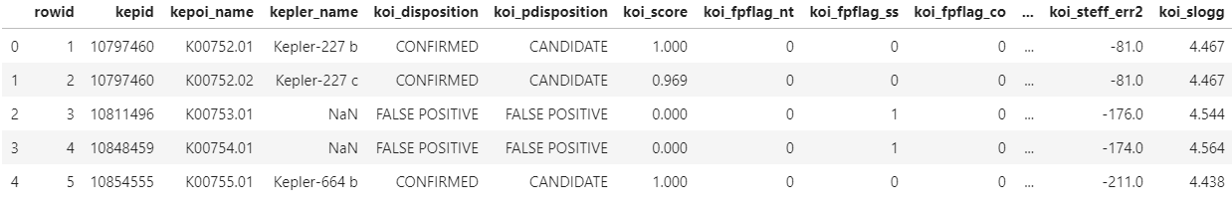
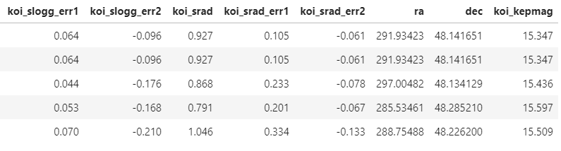

Data Cleaning
Undesirable values were legion in the dataset and required the cleaning of it.
Here’s what was done:
Programming Language: Python
Program Terminal
Programming Language: Python
Output Terminal
import pandas as pd
raw_data=pd.read_csv('cumulative.csv’)
raw_data.head()
×
×
5 rows $×$ 50 columns

Slide 4
Data Cleaning
Undesirable values were legion in the dataset and required the cleaning of it.
Here’s what was done:
Programming Language: Python
Program Terminal
Programming Language: Python
Output Terminal
import pandas as pd
raw_data=pd.read_csv('cumulative.csv’)
raw_data.head()
all the columns: ['rowid', 'kepid', 'kepoi_name', 'kepler_name', 'koi_disposition', 'koi_pdisposition', 'koi_score', 'koi_fpflag_nt', 'koi_fpflag_ss', 'koi_fpflag_co', 'koi_fpflag_ec', 'koi_period', 'koi_period_err1', 'koi_period_err2', 'koi_time0bk', 'koi_time0bk_err1', 'koi_time0bk_err2', 'koi_impact', 'koi_impact_err1', 'koi_impact_err2', 'koi_duration', 'koi_duration_err1', 'koi_duration_err2', 'koi_depth', 'koi_depth_err1', 'koi_depth_err2', 'koi_prad', 'koi_prad_err1', 'koi_prad_err2', 'koi_teq', 'koi_teq_err1', 'koi_teq_err2', 'koi_insol', 'koi_insol_err1', 'koi_insol_err2', 'koi_model_snr', 'koi_tce_plnt_num', 'koi_tce_delivname', 'koi_steff', 'koi_steff_err1', 'koi_steff_err2', 'koi_slogg', 'koi_slogg_err1', 'koi_slogg_err2', 'koi_srad', 'koi_srad_err1', 'koi_srad_err2', 'ra', 'dec', 'koi_kepmag']
print('all the columns:\n')
print(raw_data.columns.tolist())
5 rows $×$ 50 columns

Slide 5
Data Cleaning
Undesirable values were legion in the dataset and required the cleaning of it.
Here’s what was done:
Programming Language: Python
Program Terminal
Programming Language: Python
Output Terminal
# columns we don't want
koi_pond = ['koi_pdisposition', 'koi_tce_plnt_num', 'koi_tce_delivname', 'kepler_name']
#iterate through the columns of the raw data to add the uncertainty/error ones to the drop-list (koi_pond)
cols = raw_data.columns
# to make dropping the error columns easier,
# go through the whole list and drop every column with 'err' in the name.
for c in cols:
if 'err' in c:
koi_pond.append(c)
# finalize changes
data = raw_data.drop(koi_pond, axis = 1)
print("Dropped:\n\n", koi_pond)
print(f"\dataset had {raw_data.shape[1]} columns.\nIt now has {data.shape[1]} columns.")
Dropped: ['koi_pdisposition', 'koi_tce_plnt_num', 'koi_tce_delivname', 'kepler_name', 'koi_period_err1', 'koi_period_err2', 'koi_time0bk_err1', 'koi_time0bk_err2', 'koi_impact_err1', 'koi_impact_err2', 'koi_duration_err1', 'koi_duration_err2', 'koi_depth_err1', 'koi_depth_err2', 'koi_prad_err1', 'koi_prad_err2', 'koi_teq_err1', 'koi_teq_err2', 'koi_insol_err1', 'koi_insol_err2', 'koi_steff_err1', 'koi_steff_err2', 'koi_slogg_err1', 'koi_slogg_err2', 'koi_srad_err1', 'koi_srad_err2'] \dataset had 50 columns. It now has 24 columns.
import pandas as pd
raw_data=pd.read_csv('cumulative.csv’)
raw_data.head()
print('all the columns:\n')
print(raw_data.columns.tolist())

Slide 6
Data Cleaning
Undesirable values were legion in the dataset and required the cleaning of it.
Here’s what was done:
Programming Language: Python
Program Terminal
Programming Language: Python
Output Terminal
# get rid of rows with NaN values
data = data.dropna()
print(f"The dataset had {raw_data.shape[0]} rows. It now has {data.shape[0]} rows.\n({raw_data.shape[0]-data.shape[0]} rows were dropped, leaving {round(((data.shape[0]/raw_data.shape[0])*100),2)}% of the original number of entries.)")
The dataset had 9564 rows. It now has 7994 rows. (1570 rows were dropped, leaving 83.58% of the original number of entries.)

Slide 7
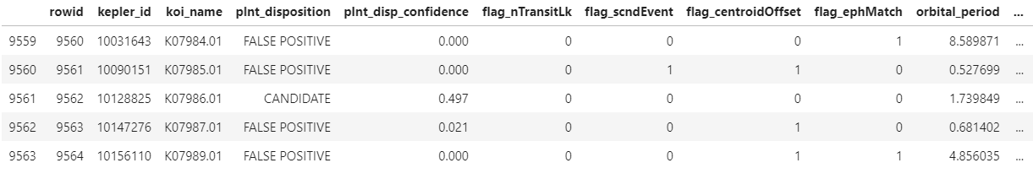
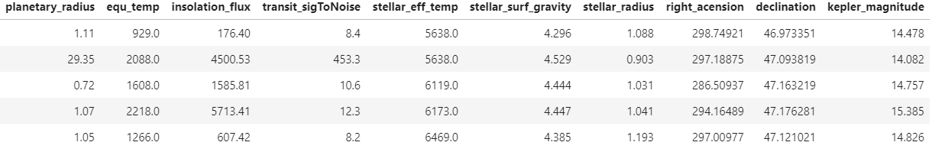

Data Cleaning
Undesirable values were legion in the dataset and required the cleaning of it.
Here’s what was done:
Programming Language: Python
Program Terminal
Programming Language: Python
Output Terminal
#renamecolumns so helpful during our exploratory analysis
data.rename(columns={'kepid':'kepler_id','kepoi_name':'koi_name','koi_disposition':'plnt_disposition', 'koi_score':'plnt_disp_confidence',
'koi_fpflag_nt':'flag_nTransitLk', 'koi_fpflag_ss':'flag_scndEvent', 'koi_fpflag_co':'flag_centroidOffset',
'koi_fpflag_ec':'flag_ephMatch', 'koi_period':'orbital_period','koi_time0bk':'transit_epoch','koi_impact':'impact_parameter',
'koi_duration':'transit_duration','koi_depth':'transit_depth', 'koi_prad':'planetary_radius', 'koi_teq':'equ_temp',
'koi_insol':'insolation_flux','koi_model_snr':'transit_sigToNoise','koi_steff':'stellar_eff_temp','koi_slogg':'stellar_surf_gravity',
'koi_srad':'stellar_radius','ra':'right_acension','dec':'declination','koi_kepmag':'kepler_magnitude'
}, inplace = True)
data.tail()
×
×
5 rows $×$ 24 columns

Slide 8
Data Cleaning
Undesirable values were legion in the dataset and required the cleaning of it.
Here’s what was done:
Programming Language: Python
Program Terminal
Programming Language: Python
Output Terminal
#Making a dictionary explaining all the columns
columns_list = data.columns.tolist()
print(columns_list)
['rowid', 'kepler_id', 'koi_name', 'plnt_disposition', 'plnt_disp_confidence', 'flag_nTransitLk', 'flag_scndEvent', 'flag_centroidOffset', 'flag_ephMatch', 'orbital_period', 'transit_epoch', 'impact_parameter', 'transit_duration', 'transit_depth', 'planetary_radius', 'equ_temp', 'insolation_flux', 'transit_sigToNoise', 'stellar_eff_temp', 'stellar_surf_gravity', 'stellar_radius', 'right_acension', 'declination', 'kepler_magnitude']

Slide 9
Data Cleaning
Undesirable values were legion in the dataset and required the cleaning of it.
Here’s what was done:
Programming Language: Python
Program Terminal
Programming Language: Python
Output Terminal
artifacts, non-eclipsing variable stars, and spurious (very low SNR) detections.',
'stellar eclipse. flag indicating a KOI that is observed to have a significant secondary event, transit shape, or out-of-eclipse variability, which indicates that the transit-like event is most likely caused by an eclipsing binary. ',
'centroid offset. flag indicating a KOI where the source of the signal is from a nearby star, as inferred by measuring the centroid location of the image both in and out of transit, or by the strength of the transit signal in the target\'s outer (halo) pixels as compared to the transit signal from the pixels in the optimal (or core) aperture',
'ephemeris match indicates contamination. flag indicating a KOI that shares the same period and epoch as another
'Stellar Surface Gravity (log_10 (cm/s^2)). The base-10 logarithm of the acceleration due to gravity at the surface of the star.',
'Stellar Radius (solar radii). The photospheric radius of the star.',
'KIC Right Acension',
'KIC Declination',
'Kepler-band magnitude’,
]
df=pd.DataFrame(data)
df.to_csv(‘D:\PESU\2nd year\Data Science\Project’)
print("Export Success")
'Planetary radius (Earth radii). The product of the planet-star radius ratio and the stellar radius.',
'Equilibrium Temperature (Kelvin). An approximate temperature of the planet/object.',
'Insolation Flux [Earth flux]. Insolation flux is another way to give the equilibrium temperature. It depends on the stellar parameters (specifically the stellar radius and temperature), and on the semi-major axis of the planet. It\'s given in units relative to those measured for the Earth from the Sun.',
'Transit Signal-to-Noise. Transit depth normalized by the mean uncertainty in the flux during the transits.',
'Stellar Effective Temperature (Kelvin). The photospheric temperature of the star the KOI orbits.',
object and is judged to be the result of flux contamination in the aperture or electronic crosstalk.',
'orbital period (days)',
'The time corresponding to the center of the first detected transit in Barycentric Julian Day (BJD) minus a constant offset of 2,454,833.0 days. The offset corresponds to 12:00 on Jan 1, 2009 UTC.',
'The sky-projected distance between the center of the stellar disc and the center of the planet disc at conjunction, normalized by the stellar radius.',
'Transit Duration (hours). The duration of the observed transits. Duration is measured from first contact between the planet and star until last contact.',
'Transit Depth (parts per million). The fraction of stellar flux lost at the minimum of the planetary transit.',
desc_list = [
'the row ID',
'target identification number as listed in the Kepler Input Catalog',
'number used to track a KOI (Kepler Object of Interest)',
'exoplanet status of this KOI from the Exoplanet Archive. Values are either FALSE POSITIVE, CANDIDATE, or CONFIRMED [exoplanet]',
'value between 0 and 1 indicating confidence in KOI disposition. For CANDIDATEs, a higher value indicates more confidence in its disposition, while for FALSE POSITIVEs, a higher value indicates less confidence in that disposition.',
'not transit-like. flag indicating a KOI whose light curve is not consistent with that of a transiting planet. This includes, but is not limited to, instrumental
Export Success

Slide 10
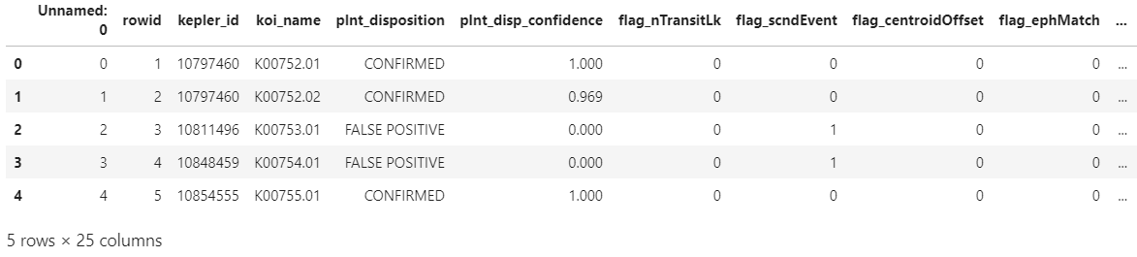
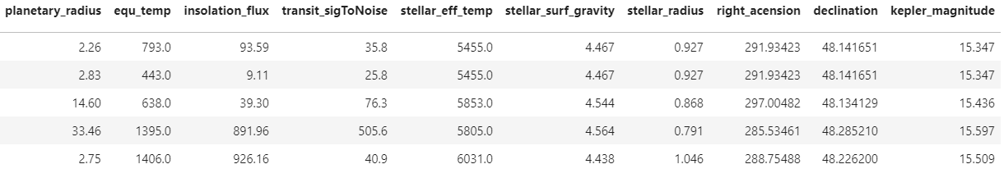

Graph Visualisation
After cleaning the dataset, graphs were visualised.
Here’s what was done:
Programming Language: Python
Program Terminal
Programming Language: Python
Output Terminal
import numpy as np
import pandas as pd
import matplotlib.pyplot as plt
df = pd.read_csv('cumulative-normalized.csv')
# Numerical Plot
fig = df.head().plot.box(x = 'kepler_id', y = 'impact_parameter', title='Impact parameter VS Kepler ID')
fig = df.head().plot.box(x = 'kepler_id', y = 'equ_temp', title='Equilibrium temperature VS Kepler ID')
fig = df.head().plot.box(x = 'kepler_id', y = 'transit_duration', title='Transit Duration VS Kepler ID')
# Categorical Plot
fig = df.head().plot.bar(x = 'kepler_id', y = 'impact_parameter', title='Impact parameter VS Kepler ID')
fig = df.head().plot.bar(x = 'kepler_id', y = 'equ_temp', title='Equilibrium temperature VS Kepler ID')
fig = df.head().plot.bar(x = 'kepler_id', y = 'transit_duration', title='Transit Duration VS Kepler ID')
df.head()
×
×
5 rows $×$ 25 columns

Slide 11
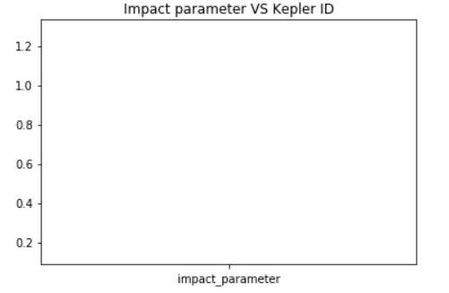
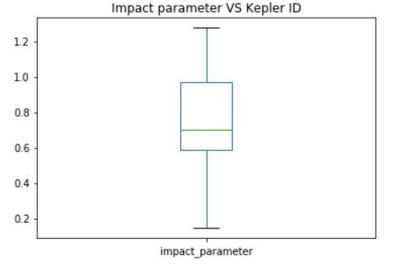
Graph Visualisation
After cleaning the dataset, graphs were visualised.
Here’s what was done:
Programming Language: Python
Program Terminal
Programming Language: Python
Output Terminal
import numpy as np
import pandas as pd
import matplotlib.pyplot as plt
df = pd.read_csv('cumulative-normalized.csv')
# Numerical Plot
fig = df.head().plot.box(x = 'kepler_id', y = 'impact_parameter', title='Impact parameter VS Kepler ID')
fig = df.head().plot.box(x = 'kepler_id', y = 'equ_temp', title='Equilibrium temperature VS Kepler ID')
fig = df.head().plot.box(x = 'kepler_id', y = 'transit_duration', title='Transit Duration VS Kepler ID')
# Categorical Plot
fig = df.head().plot.bar(x = 'kepler_id', y = 'impact_parameter', title='Impact parameter VS Kepler ID')
fig = df.head().plot.bar(x = 'kepler_id', y = 'equ_temp', title='Equilibrium temperature VS Kepler ID')
fig = df.head().plot.bar(x = 'kepler_id', y = 'transit_duration', title='Transit Duration VS Kepler ID')
df.head()

Slide 12
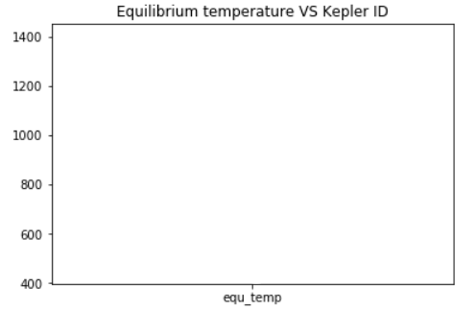
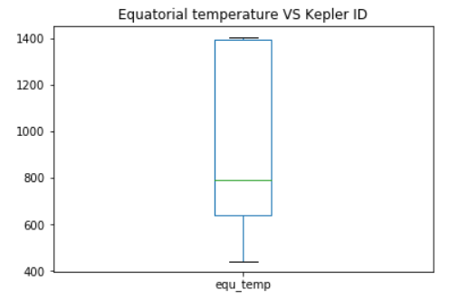
Graph Visualisation
After cleaning the dataset, graphs were visualised.
Here’s what was done:
Programming Language: Python
Program Terminal
Programming Language: Python
Output Terminal
import numpy as np
import pandas as pd
import matplotlib.pyplot as plt
df = pd.read_csv('cumulative-normalized.csv')
# Numerical Plot
fig = df.head().plot.box(x = 'kepler_id', y = 'impact_parameter', title='Impact parameter VS Kepler ID')
fig = df.head().plot.box(x = 'kepler_id', y = 'equ_temp', title='Equilibrium temperature VS Kepler ID')
fig = df.head().plot.box(x = 'kepler_id', y = 'transit_duration', title='Transit Duration VS Kepler ID')
# Categorical Plot
fig = df.head().plot.bar(x = 'kepler_id', y = 'impact_parameter', title='Impact parameter VS Kepler ID')
fig = df.head().plot.bar(x = 'kepler_id', y = 'equ_temp', title='Equilibrium temperature VS Kepler ID')
fig = df.head().plot.bar(x = 'kepler_id', y = 'transit_duration', title='Transit Duration VS Kepler ID')
df.head()

Slide 13
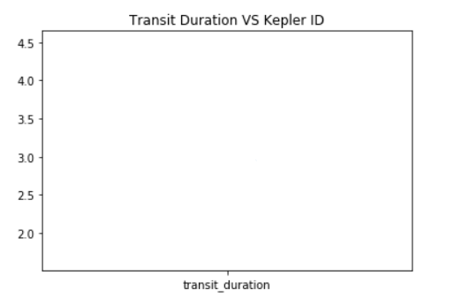
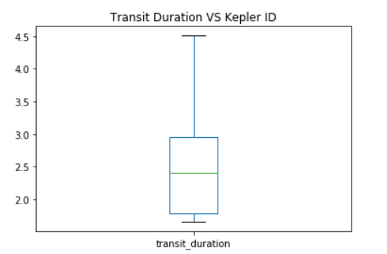
Graph Visualisation
After cleaning the dataset, graphs were visualised.
Here’s what was done:
Programming Language: Python
Program Terminal
Programming Language: Python
Output Terminal
import numpy as np
import pandas as pd
import matplotlib.pyplot as plt
df = pd.read_csv('cumulative-normalized.csv')
# Numerical Plot
fig = df.head().plot.box(x = 'kepler_id', y = 'impact_parameter', title='Impact parameter VS Kepler ID')
fig = df.head().plot.box(x = 'kepler_id', y = 'equ_temp', title='Equilibrium temperature VS Kepler ID')
fig = df.head().plot.box(x = 'kepler_id', y = 'transit_duration', title='Transit Duration VS Kepler ID')
# Categorical Plot
fig = df.head().plot.bar(x = 'kepler_id', y = 'impact_parameter', title='Impact parameter VS Kepler ID')
fig = df.head().plot.bar(x = 'kepler_id', y = 'equ_temp', title='Equilibrium temperature VS Kepler ID')
fig = df.head().plot.bar(x = 'kepler_id', y = 'transit_duration', title='Transit Duration VS Kepler ID')
df.head()

Slide 14
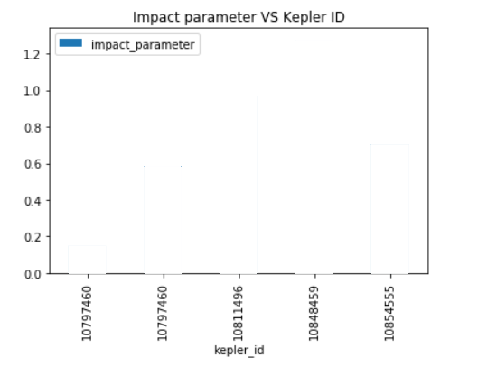
Graph Visualisation
After cleaning the dataset, graphs were visualised.
Here’s what was done:
Programming Language: Python
Program Terminal
Programming Language: Python
Output Terminal
import numpy as np
import pandas as pd
import matplotlib.pyplot as plt
df = pd.read_csv('cumulative-normalized.csv')
# Numerical Plot
fig = df.head().plot.box(x = 'kepler_id', y = 'impact_parameter', title='Impact parameter VS Kepler ID')
fig = df.head().plot.box(x = 'kepler_id', y = 'equ_temp', title='Equilibrium temperature VS Kepler ID')
fig = df.head().plot.box(x = 'kepler_id', y = 'transit_duration', title='Transit Duration VS Kepler ID')
# Categorical Plot
fig = df.head().plot.bar(x = 'kepler_id', y = 'impact_parameter', title='Impact parameter VS Kepler ID')
fig = df.head().plot.bar(x = 'kepler_id', y = 'equ_temp', title='Equilibrium temperature VS Kepler ID')
fig = df.head().plot.bar(x = 'kepler_id', y = 'transit_duration', title='Transit Duration VS Kepler ID')
df.head()

Slide 15
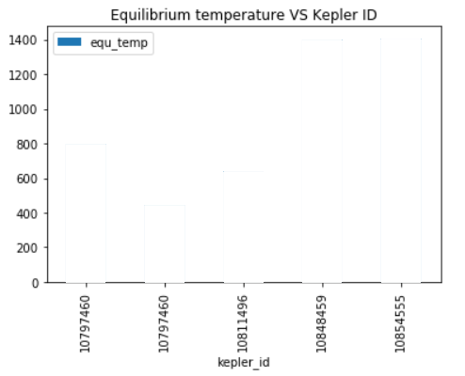
Graph Visualisation
After cleaning the dataset, graphs were visualised.
Here’s what was done:
Programming Language: Python
Program Terminal
Programming Language: Python
Output Terminal
import numpy as np
import pandas as pd
import matplotlib.pyplot as plt
df = pd.read_csv('cumulative-normalized.csv')
# Numerical Plot
fig = df.head().plot.box(x = 'kepler_id', y = 'impact_parameter', title='Impact parameter VS Kepler ID')
fig = df.head().plot.box(x = 'kepler_id', y = 'equ_temp', title='Equilibrium temperature VS Kepler ID')
fig = df.head().plot.box(x = 'kepler_id', y = 'transit_duration', title='Transit Duration VS Kepler ID')
# Categorical Plot
fig = df.head().plot.bar(x = 'kepler_id', y = 'impact_parameter', title='Impact parameter VS Kepler ID')
fig = df.head().plot.bar(x = 'kepler_id', y = 'equ_temp', title='Equilibrium temperature VS Kepler ID')
fig = df.head().plot.bar(x = 'kepler_id', y = 'transit_duration', title='Transit Duration VS Kepler ID')
df.head()

Slide 16
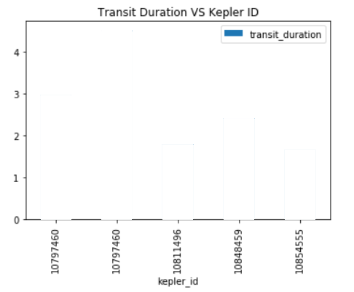
Graph Visualisation
After cleaning the dataset, graphs were visualised.
Here’s what was done:
Programming Language: Python
Program Terminal
Programming Language: Python
Output Terminal
import numpy as np
import pandas as pd
import matplotlib.pyplot as plt
df = pd.read_csv('cumulative-normalized.csv')
# Numerical Plot
fig = df.head().plot.box(x = 'kepler_id', y = 'impact_parameter', title='Impact parameter VS Kepler ID')
fig = df.head().plot.box(x = 'kepler_id', y = 'equ_temp', title='Equilibrium temperature VS Kepler ID')
fig = df.head().plot.box(x = 'kepler_id', y = 'transit_duration', title='Transit Duration VS Kepler ID')
# Categorical Plot
fig = df.head().plot.bar(x = 'kepler_id', y = 'impact_parameter', title='Impact parameter VS Kepler ID')
fig = df.head().plot.bar(x = 'kepler_id', y = 'equ_temp', title='Equilibrium temperature VS Kepler ID')
fig = df.head().plot.bar(x = 'kepler_id', y = 'transit_duration', title='Transit Duration VS Kepler ID')
df.head()

Slide 17
Normalization and Standardisation
Not all values in the dataset had mean and variance between 0 and 1, so normalization was to be performed.
Here’s what was done:
Programming Language: Python
Program Terminal
Programming Language: Python
Output Terminal
for col in columns[0:4]:
for i in range(0,7994):
rows_temp_list.append(df.iloc[i][col])
rows_dict[col]=rows_temp_list
rows_temp_list = []
for col in columns[4:]:
for i in range(0,7994):
x = df.loc[i][col]
mu=col_dict[col][0]
sigma=col_dict[col][1]
z = (x - mu) / sigma
z_temporary_list.append(abs(z))
z_dict[col]=z_temporary_list
z_temporary_list = []
import pandas as pd
import math
df = pd.read_csv('cumulative-cleaned.csv')
columns = df.columns[1:]
col_dict = {}
z_temporary_list = []
z_dict = {}
rows_dict = {}
rows_temp_list = []
for col in columns[4:]:
std = df.iloc[:7995][col].std()
var = df.iloc[:7995][col].var()
mean = df.iloc[:7995][col].mean()
col_dict[col]=[mean,std]
Normalized dataset saved in 'cumulative-normalized.csv
full_dict = {}
for i in rows_dict:
full_dict[i]=rows_dict[i]
for i in z_dict:
full_dict[i]=z_dict[i]
kepler_normd=pd.DataFrame(full_dict)
kepler_normd.to_csv('cumulative-normalized.csv')
print("Normalized dataset saved in 'cumulative-normalized.csv'")

Slide 18
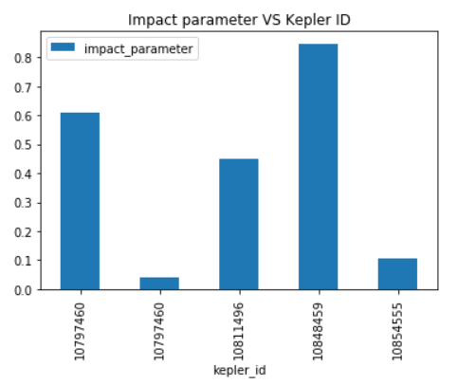
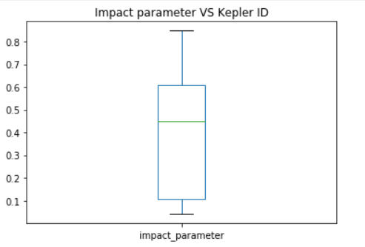
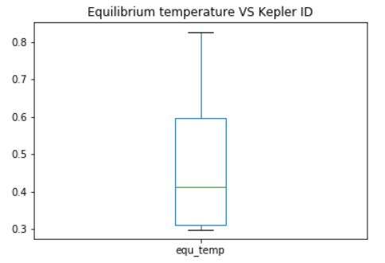
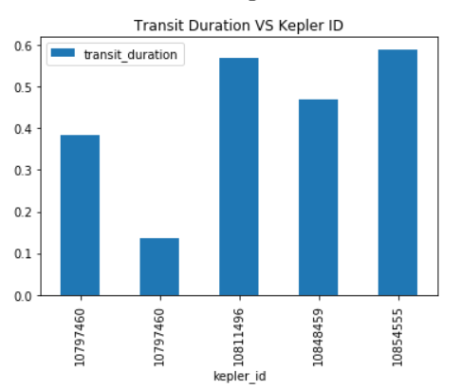
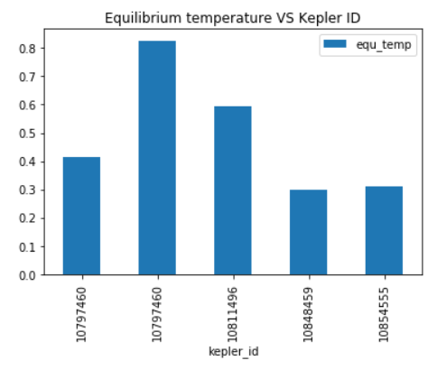
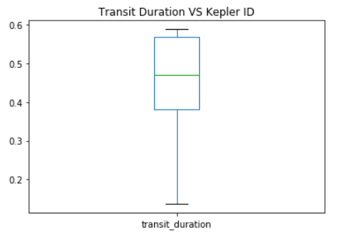
Graph Visualisation for the normalized data
After normalizing the dataset, graphs were visualised again.
Bar Graphs
Box Plots

Slide 19
Hypothesis testing and Correlation
A hypothesis test was performed over the values in the dataset.
Here’s what was done:
Programming Language: Python
Program Terminal
Programming Language: Python
Output Terminal
mu: 43.81602841668751 , sigma: 3.6033554370102445
[9]:
Ttest_1sampResult(statistic=-4.564556101593331, pvalue=5.080325086833945e-06)
mu = 8124.301745058795 sigma = 168949.57357307704
Ttest_indResult(statistic=-6.0078480021310945, pvalue=1.986711332306377e-09)
print(data['insolation_flux'].head().mean())
-0.10233762828280667
import numpy as np
z_critical = 1.96 #alpha level of 0.05 and two-tailed test
mean = 392.024
n = 5
standard_deviation = sigma/np.sqrt(n)
z = (mean - mu)/standard_deviation # Ho: sample mean = population mean H1:sample mean not equal to population mean
print(z)
# z=-0.10233762828280667 which gives z < 1.96 hence rejecting null hypotheses
392.024
in_flux = data['insolation_flux']
mu = in_flux.mean()
sigma = in_flux.std(ddof=0)
print("mu = ",mu,"sigma = ",sigma)
# performing two sample t-test,testing whether the mean in number of
# To test if this is significant, we do a 2-sample t-test with scipy.stats.ttest_ind():
plnt_confirmed= data[data['plnt_disposition'] == 'CONFIRMED']['orbital_period']
plnt_fpositive= data[data['plnt_disposition'] == 'FALSE POSITIVE']['orbital_period']
st.ttest_ind(plnt_confirmed,plnt_fpositive) # Ho:mu(FALSE POSITIVE) not equal to mu(CONFIRMED) H1:mu(FALSE POSITIVE) = mu(CONFIRMED)
# so p=1.987e-09 which gives p < 0.05 hence null hypothesis is rejected
import pandas as pd
import seaborn as sns
from scipy import stats as st
data=pd.read_csv("cumulative-cleaned.csv")
points =data['declination']
mu = points.mean()
sigma = points.std(ddof=0)
print("mu: ", mu, ", sigma:", sigma)
#Performing STATISTICAL TESTS
#Performing one sample t -test(testing whether it is equal to poulation mean or not)
data=data.loc[:,~data.columns.str.contains('^Unnamed')]
st.ttest_1samp(data['declination'],44) #Ho:mu=44 H1:mu not equal to 44
More information

Slide 20
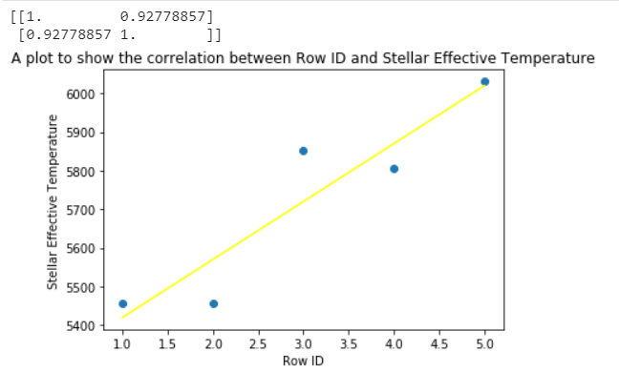
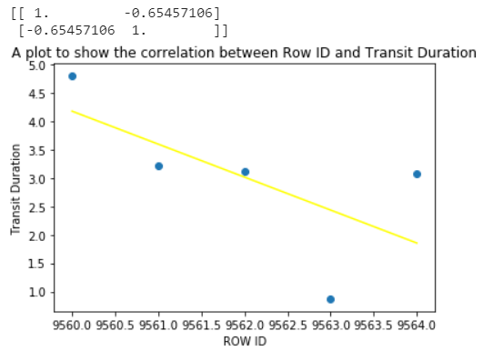
Hypothesis testing and Correlation
A correlation test was also performed over the values in the dataset.
Here’s what was done:
Programming Language: Python
Program Terminal
Programming Language: Python
Output Terminal
import numpy as np
import pandas as pd
import matplotlib.pyplot as plt
data = pd.read_csv('cumulative-cleaned.csv')
x = data.tail()['rowid']
y = data.tail()['transit_duration']
print(np.corrcoef(x, y))
plt.scatter(x, y)
plt.title('A plot to show the correlation between Row ID and Transit Duration')
plt.xlabel('ROW ID')
plt.ylabel('Transit Duration')
plt.plot(np.unique(x), np.poly1d(np.polyfit(x, y, 1))(np.unique(x)), color='yellow') #adding the line of best fit
plt.show()
#The below graph shows a negative correlation whose coeffecient is -0.6546
import numpy as np
import pandas as pd
import matplotlib.pyplot as plt
data = pd.read_csv('cumulative-cleaned.csv')
x = data.head()['rowid']
y = data.head()['stellar_eff_temp']
print(np.corrcoef(x, y))
plt.scatter(x, y)
plt.title('A plot to show the correlation between Row ID and Stellar Effective Temperature')
plt.xlabel('Row ID')
plt.ylabel('Stellar Effective Temperature')
plt.plot(np.unique(x), np.poly1d(np.polyfit(x, y, 1))(np.unique(x)), color='yellow') #adding the line of best fit
plt.show()
#The below graph shows a positive correlation whose coeffecient is 0.9278
More information

Slide 21
Hypothesis testing and Correlation
A correlation test was also performed over the values in the dataset.
Here’s what was done:
Programming Language: Python
Program Terminal
Programming Language: Python
Output Terminal
More information

Slide 22
The End

